Slide 1
Supply Chain Performance Analysis and Optimization
Presented by:
Kholoud Hagag ·
Mahmoud Seera ·
Ahmed Hussein ·
Reham Sobeeh.
Instructor: Eng. Sherihan Ali
Company: YTH

Slide 2
Project Background & Business Problem
Background:
This project focuses on improving supply chain efficiency and performance through data analytics and Power BI visualization.
The analysis covers sourcing, manufacturing, inventory, and logistics functions to identify bottlenecks and cost inefficiencies.
Business Problem:
Inefficient inventory control → stockouts & overstock
High, inconsistent shipping costs
Supplier delays and quality issues
Lack of visibility across the supply chain

Slide 3
Project Objectives & Scope
Objectives:
Analyze key performance drivers across supply chain stages.
Optimize inventory levels to balance cost and availability.
Improve logistics efficiency and delivery times.
Evaluate supplier performance based on reliability and quality.
Provide actionable insights via an interactive Power BI dashboard.
Scope:
Focuses on descriptive and diagnostic analysis using existing company data to identify improvement opportunities.

Slide 4
Data overview and data model
Source: The initial data was extracted from a Comma-Separated Values (CSV) file containing raw transactional, quality, and production metrics from the company’s supply chain system.
Data Cleaning & Preparation: The dataset was processed and transformed using Power BI (Power Query) to handle missing values, remove duplicates, and ensure consistency across product, supplier, and logistics data.
Data Measures: Critical analytical measures were created using DAX (Data Analysis Expressions) — including KPIs such as Inventory Turnover, Lead Time, Defect Rate, and Manufacturing Cost per Unit — to enable accurate and dynamic performance analysis.

Slide 5
Analysis and insights

Slide 6
Key Performance Indicators (KPIs) Summary
Metric | Value | Insight / Benchmark
Total Revenue | $677.8K | Indicates strong sales performance within the observed period.
Profit Margin | 16.84% | Reflects moderate profitability — potential to improve through cost optimization.
Overall Defect Rate | 2.25% | Within acceptable range, but continued quality monitoring is recommended.
Average Cost per Unit | $1.15 | Suggests efficient production cost management across product lines.
Failed / Pending Inspections | 47% | Highlights a bottleneck in the inspection process, requiring immediate attention.

Slide 7
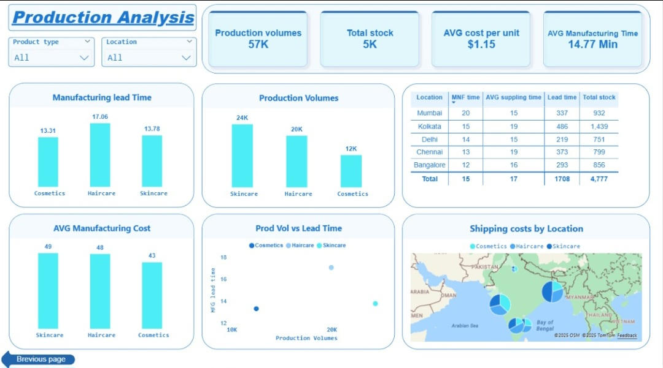
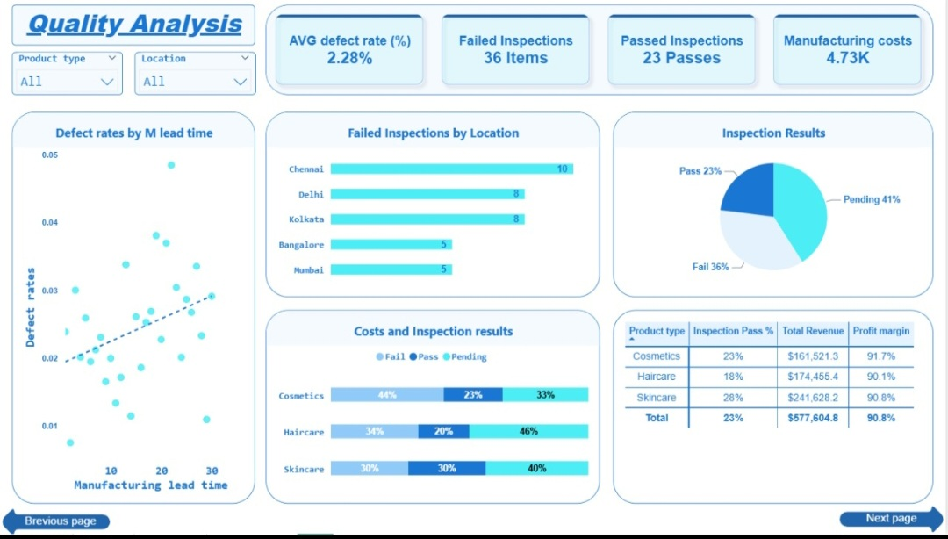
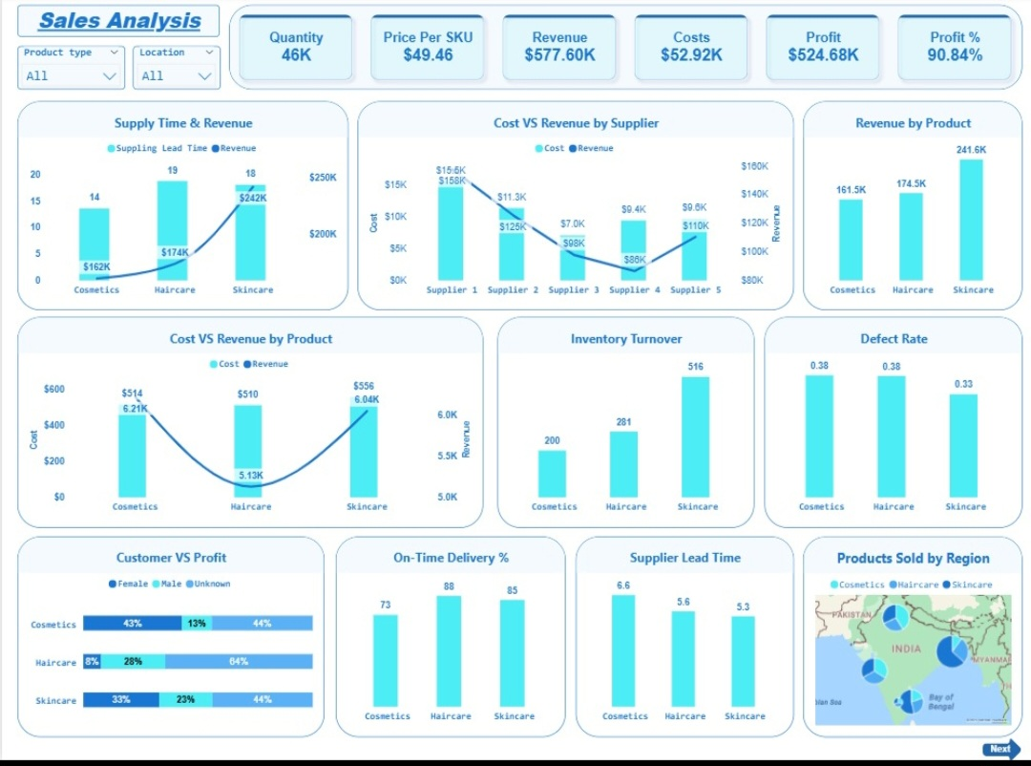
The supply chain dashboards

Slide 8
Insight 1: The Haircare Product Gap
Focus:
Haircare products represent a high-revenue category, yet they show signs of operational inefficiency and profitability challenges.
Key Findings:
Highest Inspection Fees: Account for 41% of total inspection costs.
Lowest Profit Margin: Only 10.1%, well below the product line average.
Highest Defect Rate: 6.3%, indicating consistent quality control issues.
Conclusion:
Despite being a top revenue generator, Haircare products act as a major operational and financial drain.
Immediate focus should be placed on quality improvement, inspection cost reduction, and process optimization within this category.
Focus:
Haircare products represent a high-revenue category, yet they show signs of operational inefficiency and profitability challenges.
Key Findings:
Highest Inspection Fees: Account for 41% of total inspection costs.
Lowest Profit Margin: Only 10.1%, well below the product line average.
Highest Defect Rate: 6.3%, indicating consistent quality control issues.
Conclusion:
Despite being a top revenue generator, Haircare products act as a major operational and financial drain.
Immediate focus should be placed on quality improvement, inspection cost reduction, and process optimization within this category.

Slide 9
Insight 2: Quality vs. Lead Time Correlation
Focus:
The Quality Analysis scatter plot reveals a clear trend between manufacturing lead time and defect rate.
Key Findings:
Longer Manufacturing Lead Times are directly correlated with higher defect rates.
Haircare products, which have the longest lead times, show the highest defect probability among all categories. The pattern suggests process inefficiency contributes significantly to quality issues.
Conclusion:
Extended production cycles lead to higher defects.
Recommendation: Conduct an efficiency and workflow review to shorten lead times, streamline inspection steps, and reduce defect occurrence.

Slide 10
Insight 3: Inspection & Cost Bottlenecks
Focus:
Analysis of inspection results and shipping cost distribution highlights key operational inefficiencies affecting profitability.
Key Findings:
Inspection Delays:
Nearly 47% of inspections remain pending, causing inventory turnover slowdowns and increased indirect holding costs.
Supplier Cost Imbalance:
Supplier 1 and Supplier 2 show high cost-to-revenue ratios, signaling poor cost efficiency.
Logistics Concern:
Western region shipping costs are significantly above average, suggesting a need for route optimization or contract renegotiation.
Conclusion:
The combination of inspection delays and cost concentration creates a bottleneck that impacts both operational flow and profitability.
Recommendation: Prioritize process automation in inspections and initiate supplier and logistics cost reviews to improve efficiency.

Slide 11
Actionable Recommendations
1. Haircare Product Quality Improvement
Conduct a targeted review of manufacturing and inspection processes.
Goal: Reduce Defect Rate from 6.3% → 3%.
2. Inspection Process Streamlining
Address 47% pending inspection backlog.
Implement advanced sampling, workflow optimization, or inspection automation.
3. Cost Negotiation & Logistics Optimization
Renegotiate contracts with Supplier 1 and Supplier 2 to improve cost efficiency.
Review and optimize Western region shipping contracts to reduce high logistics costs.

Slide 12
Conclusion and value delivered
Recap:
The analysis identifies Haircare product quality issues and the inspection backlog as key barriers to profitability.
Operational inefficiencies and high costs in suppliers and logistics further impact margins and inventory flow.
Value Delivered:
Profit Margin Improvement: Implementation of recommendations is projected to increase overall profit margin by 3–5 percentage points.
Inventory Efficiency: Expected to reduce pending stock by over 50%, improving inventory turnover and operational flow.
Data-Driven Insights: Provides a clear foundation for ongoing monitoring and decision-making through an interactive Power BI dashboard.

Slide 13
Thank you

